Slide 1
Online Course Enrollment System
Justin Stewart
Prof. Elchouemi
CST499: Software Architecture & Design
4/3/2023

Slide 2
Key Points of SRS
Purpose
The purpose of this Software Requirements Specification (SRS) document is to specify the requirements for the development of an Online Course Enrollment System, which will address the problem of students enrolling in online courses. This SRS document covers the entire system, including the registration process, course listing, enrollment, and waiting list.
Software Scope
The Online Course Enrollment System is a web-based application that allows students to register, view available courses, and enroll in courses offered during the three semesters per year. The system provides students with the ability to add themselves to the waiting list if a course is full and cancel enrollment from any enrolled course. The system also registers and notifies the first student on the waiting list if a spot becomes available.

Slide 3
Key Points of SRS Cont.
Product Functions
The major functions of the Online Course Enrollment System are:
New user registration and profile creation
Login for registered users
Course listing and enrollment
Maximum number of enrollments per course
Waiting list for full courses
Enrollment cancellation and notification to the waiting list
User Classes & Characteristics
The following user classes are anticipated to use the system:
Students: The primary users of the system who will register, view available courses, and enroll in courses.
Administrators: System administrators who will manage the system, including adding and removing courses, managing enrollment limits, and monitoring the waiting list.
Business Rules
Only registered users can access the system and perform any actions.
Users can cancel enrollment from any course that they are enrolled in.
Only administrators can add and remove courses, and manage enrollment limits.

Slide 4
Architectural Views: UML Diagrams
In this section, I will discuss the following UML diagrams:
Class Diagram
Use Case Diagram
Activity Diagram
Sequence Diagram
State Diagram

Slide 5
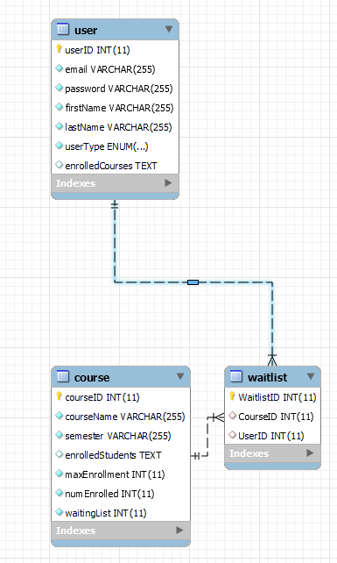
Architectural Views (Class Diagram)
Class diagrams model the components, representing the classes, attributes, and methods.

Slide 6
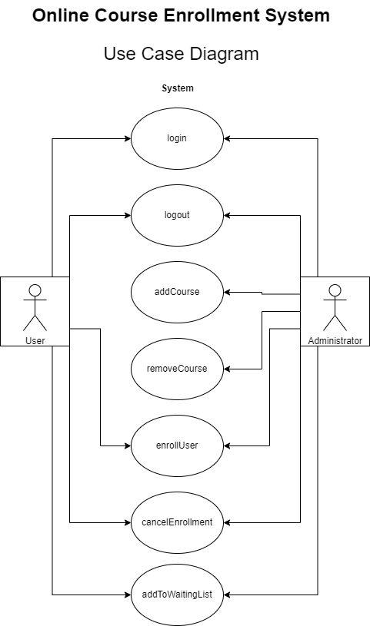
Architectural Views (Use Case)
Use Case diagrams show the different scenarios in which the software system will be used.

Slide 7
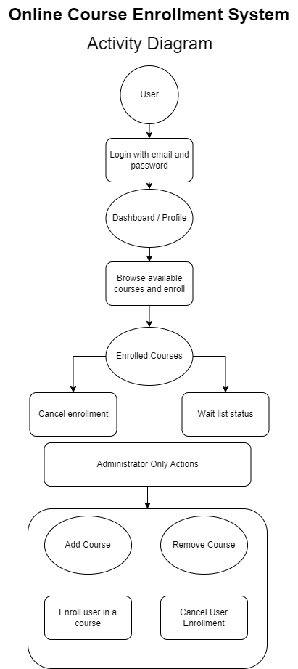
Architectural Views (Activity Diagram)
Activity diagrams model the workflow of components.

Slide 8
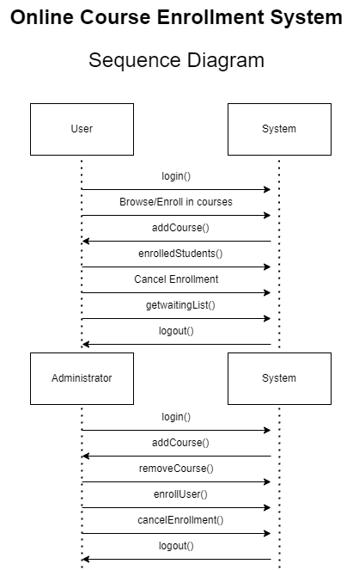
Architectural Views (Sequence Diagram)
Sequence diagrams show the interactions between components and how they communicate with each other.

Slide 9
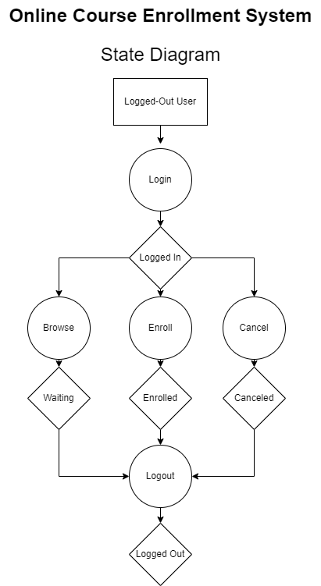
Architectural Views (State Diagram)
Shows the different states that the system can be in and the transitions between them (Tsui, Karam, & Bernal, 2016, p.155).

Slide 10
Application Design
In this section, I will discuss the design of the entire system, including the underlying source code and database design.
Pages:
Landing Page
Registration Page
Register
Login Page
Login
Add/Remove Courses To/From Catalog (Admin)
Database Changes
Register/Unregister/Waitlist (Student)
Database Changes

Slide 11
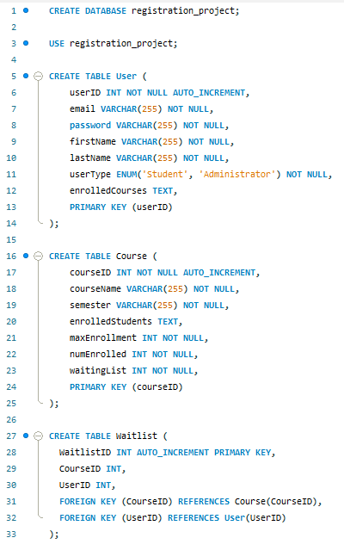
Database Creation (SQL)
The Online Course Enrollment System receives and sends data to the MySQL database via PHP's MySQLi extension (php, n.d., para.3).

Slide 12
Challenges
Throughout the development of the system:
One of the biggest challenges during the development phase was getting the correct logic to determine when users should be allowed to register for courses. This involved determining if a course was full and adding students to the waitlist if necessary. If a spot opened up in the course, the first student on the waitlist would be enrolled. Despite the difficulties, I was able to create a functioning system, but with one error. When a student registers for the final spot in the course, they are registered into the course and the waitlist, which still needs to be fixed.

Slide 13
Conclusion
In conclusion, the experience of going through the implementation phase of an Online Course Enrollment System was challenging but rewarding. I was able to create a functioning system that met the requirements outlined in the SRS document, and while there is one error, the overall system works flawlessly, which was difficult to achieve while maintaining the integrity of the data across multiple tables. Overall, I learned a great deal about development and the importance of creating a strong foundation for a system.

Slide 14
References
php. (n.d.). MySQL improved extension. php. Retrieved April 3, 2023, from https://www.php.net/manual/en/book.mysqli.php
Tsui, F. F., Bernal, B., & Karam, O. (2023).
Essentials of software engineering. Jones & Bartlett Learning.

